Slide 1
Student Performance Factors Presentation

Slide 2
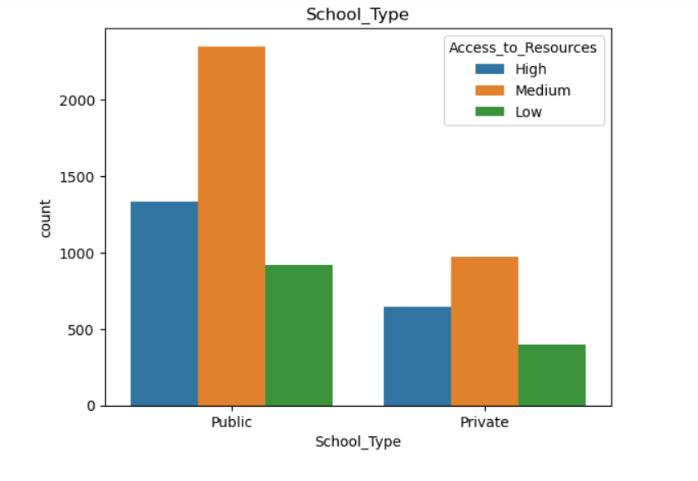
The plot will show how many students with access to resources and without access belong to different type of school . Here we can observe that students belonging to public school having good access to recourses compared to private school.

Slide 3
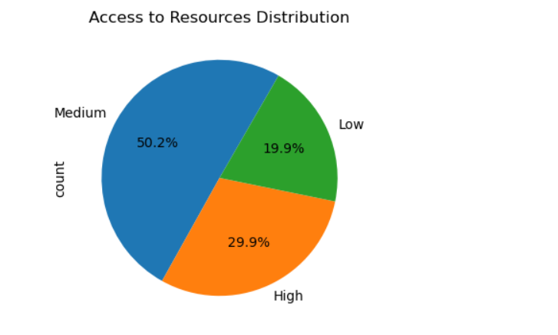
The above graph gives information regarding access to resources where schools generally have medium level of access to resources followed by high and low level.

Slide 4
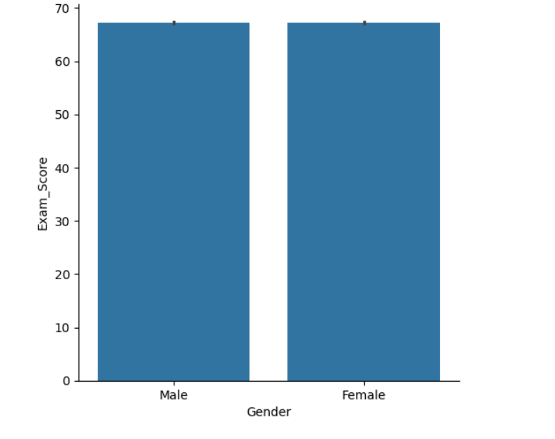
The average exam score for each gender category. The height of the bars represents the mean score for each gender. Both gender performing equally good with respect to exam scores.

Slide 5
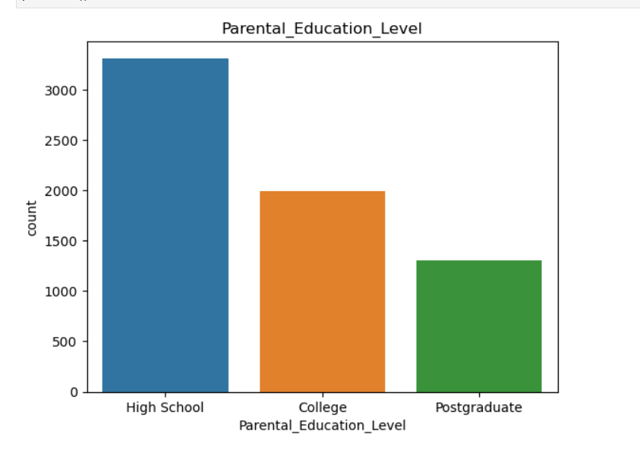
Frequency of each category in the Parental_Education_Level column. We observed that parents belonging to high school background showing highest count as compared to college and postgraduate background.

Slide 6
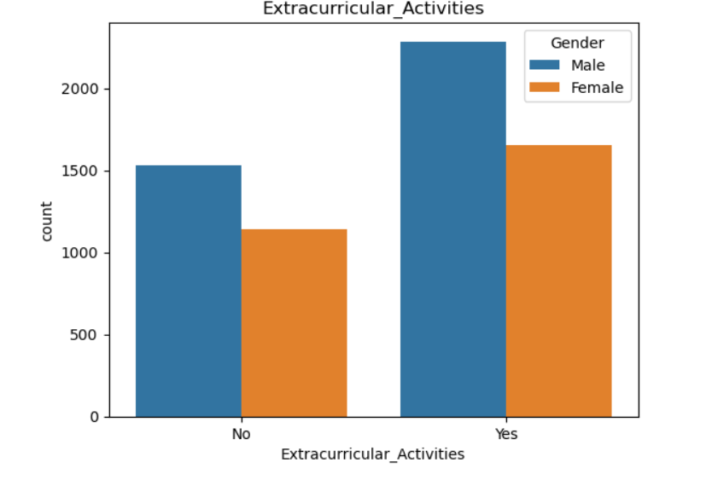
The plot will show the relative popularity of each extracurricular activity. It identifies which activities are more popular and which are less popular based on the height of the bars.

Slide 7
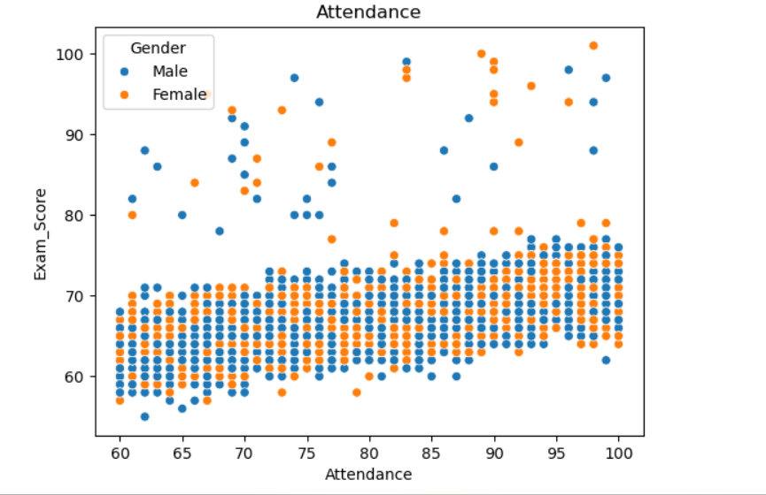
-How attendance correlates with exam performance (exam scores) and whether there are any gender-based patterns
-Whether more attendance leads to better exam scores.
-Whether gender has an impact on the relationship between attendance and exam scores.-

Slide 8
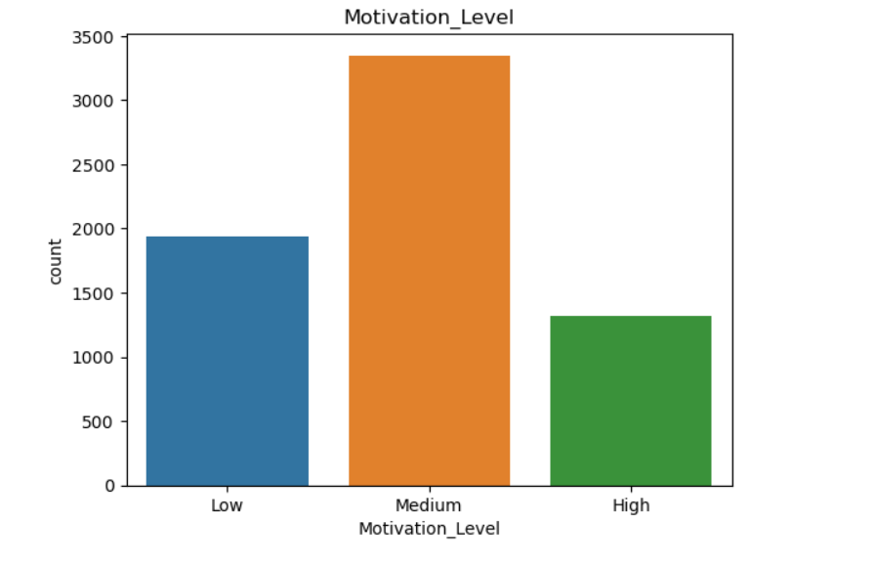
-It gives the count plot where each bar represents the count of observations for each Motivation_Level category and gives highest count of medium level motivation category.

Slide 9
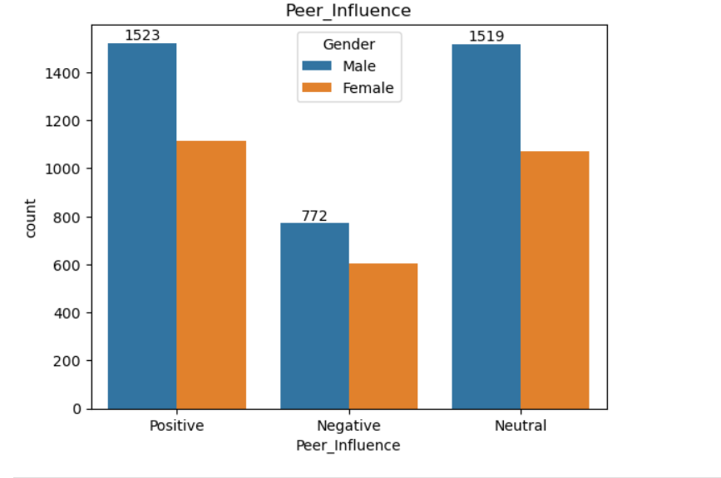
count plot that visualizes how peer influence is distributed across different genders. It groups the bars by peer influence categories, separates them by gender using different colors, and adds labels to display the count of observations for each category.

